Slide 1
PROGRESS REPORT ON ML-assisted Signal Quality Assessment of PPG Signals With Related Hardware Implementation
Presented By:
Archana Kumari
Univ. Roll no.– T91/ECE/204058
Univ Registration no.– D01-1211-0077-20
Shwashwat Das
Univ Roll no.– T91/ECE/204074
Univ Registration no.– D01-1111-0206-20
B.Tech in Electronics and Communication Engineering
Supervisor:
Dr. SUMITRA MUKHOPADHYAY
(Department of Radio Physics and Electronics, University of Calcutta)

Slide 2
Agenda
Block Diagram
Implementation Flow
Dataset explored
Doubts
References

Slide 3
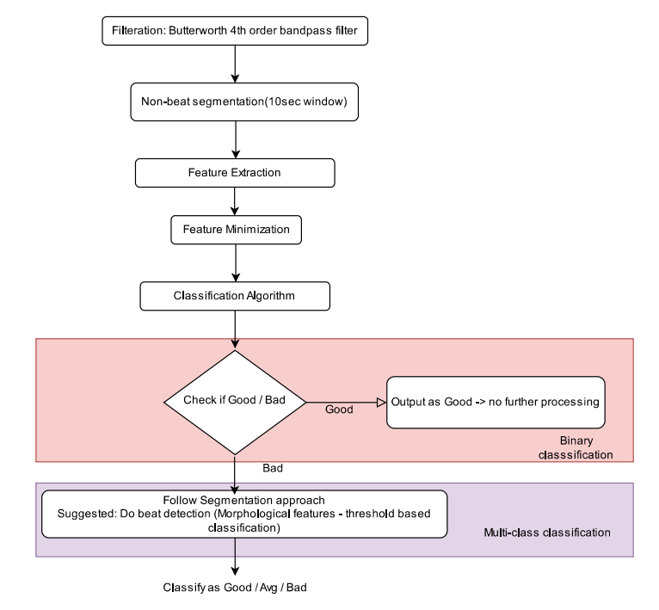
Block Diagram

Slide 4
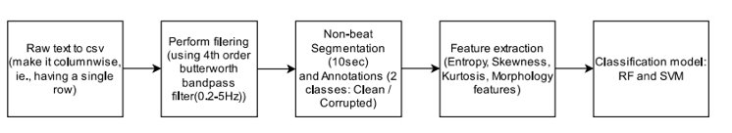
Implementation Detail:
Dataset used: BIDMC dataset
18 Subjects
125Hz PPG signals
8min long segments
Filter used: Butterworth 4th order Bandpass filter (0.2 - 5 Hz)
Segmentation: Non beat(10 sec segments)
Annotation: 2 classes – 1 (clean), 2(corrupted)
Feature Extracted: Entropy, Skewness, Kurtosis
Classification models trained: RF and SVM (k-fold cross validation used (k = 10))

Slide 5
Datasets Explored
Table 1: Datasets explored on the basis of current research papers
Dataset | Sampling Frequency | Subjects available | Duration ( per subject) | Other Features
BIDMC PPG and Respiration Dataset | 125 Hz | 53 | 8 min | Age range: 19-90
MIMIC III Waveform Dataset | 125 Hz | 30,000 (not all have PPG) | 1 hour (for 22 subjects we collected) | ICU subjects only
MIMIC PERForm AF Dataset | 125 Hz | 19 | 20 min | Atrial Fibrillation
CapnoBase IEEE TBME Respiratory Rate Benchmark | 300 Hz | 42 | 8 min | Artifact labels available
CSL Benchmark dataset | 125 Hz | 2 | 1 hour | Data from children
DaLiA Dataset | 64 Hz | 15 | 2 to 3 hours | Subjects engaged in daily activities
WESAD Dataset | 64 Hz | 15 | 2 hours | Wearable device used
We plan to take data as follows:
BIDMC: 15 subjects (15 x 8 x 6 = 720 segments)
MIMIC III Waveform Dataset: 15 subjects (15 x 8 x 6 = 720 segments)
MIMIC PERForm AF Dataset : 10 subjects (10 x 10 x 6 = 600 segments)

Slide 6
Doubts
If sampling frequency differs how to make it 125 Hz.
How to add noise?
Overlapping or non-overlapping segmentation.

Slide 7
References:
Github Repository Link: https://github.com/archana-9430/Final-year-project-Biomedical-Signal-Analysis

